Slide 1

Automating Incremental Pipelines

Slide 2


Welcome & Intros
Your Coaches
Jack Bender
Chris Fleming
Cloud Solution Architect
Squad 1
Cloud Solution Architect
Squad 2

Slide 3
What Is What The Hack ?
“What the Hack” is a challenge-based hackathon format
Challenges describe high-level tasks and goals to be accomplished
Challenges are not step-by-step labs.
By having to “figure it out”, attendee knowledge retention is greater
Attendees work in squads of 3 to 5 people to solve the challenges
Attendees “learn from” and “share with” each other.
Coaches provide technical guidance, but not answers to the squads
Coaches may provide lectures & demos to setup challenges & review solutions
What the Hack can be hosted in-person or virtually via Microsoft Teams
Notes:
Quick overview of the format….
Share this if you’re doing a Train The Trainer, or else keep hidden

Slide 4
Community Driven
Anyone can contribute a new hack
All content is available for sharing broadly to enable cloud architects and partners to re-deliver to their customers
Built from the ground up to be delivered virtually with Microsoft Teams
Notes:
Show this slide if training the trainer. Else, keep it hidden. What The Hack is a community driven collection of challenge-based hacks on the Microsoft platform.
We have a collection of over 40+ hacks to choose from.
We’ll share the content details with you after today’s hack.
If you enjoy this event, please share the content with your peers and of course…
Deliver it to your CUSTOMERS!!!

Slide 5
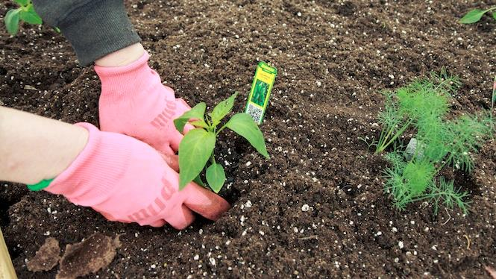
You will get your hands dirty
Notes:
This is a “hands-on” exercise where you will work in groups of 4-5 people to solve technical challenges.
You only get out what you put in, don't be lazy.
Knowledge Retention is achieved through Pain and Discomfort

Slide 6
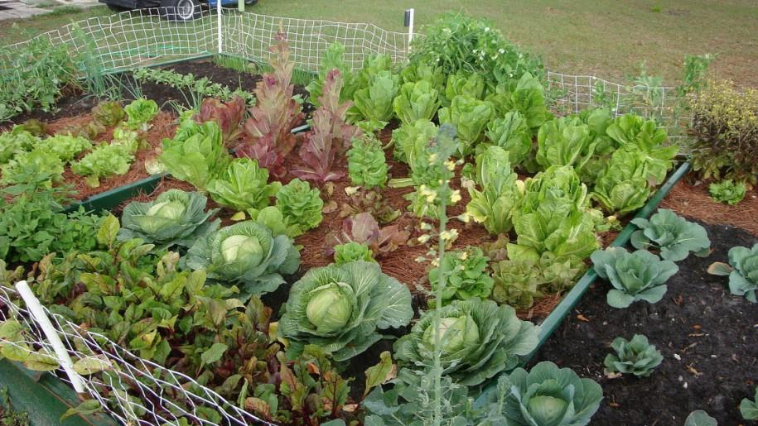
*results may vary
Notes:
You might not grow a garden like this… but at least you can learn while trying.

Slide 7

Logistics
Notes:
And now we’ll cover logistics…

Slide 8
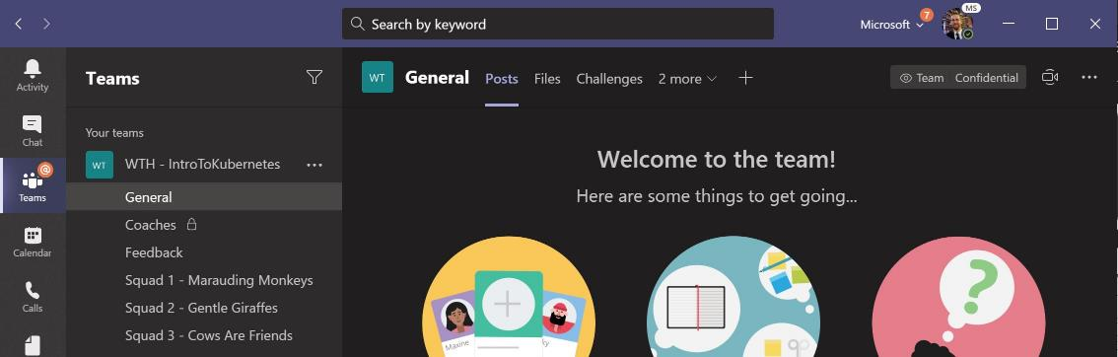
Collaboration We’re going to use Microsoft Teams in a different way…
Central gathering place. Kick-off & stand-up meetings take place HERE

Slide 9
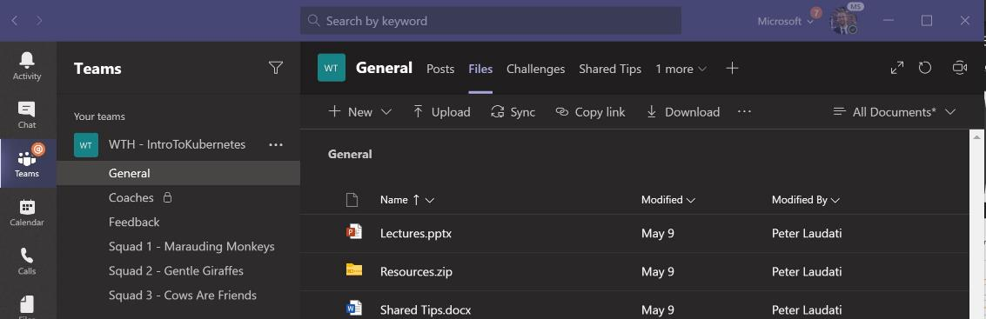
Collaboration We’re going to use Microsoft Teams in a different way…
Find any files, resources, or code samples needed for the hack, and THIS presentation HERE

Slide 10
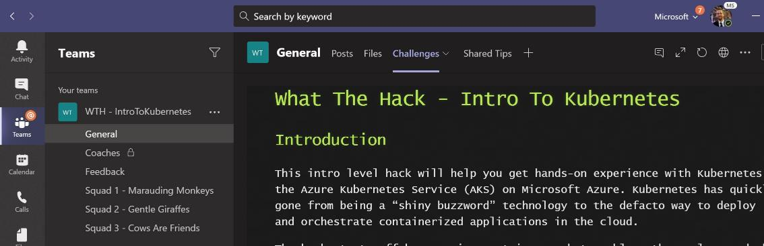
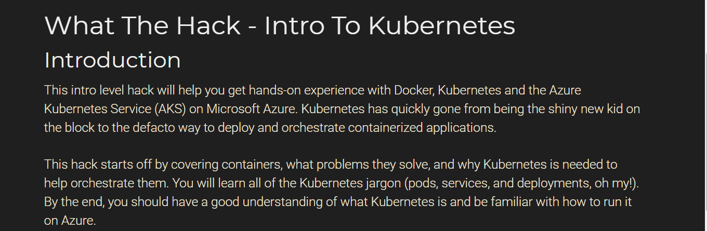
Collaboration We’re going to use Microsoft Teams in a different way…
Student Guide and Challenges are posted HERE

Slide 11
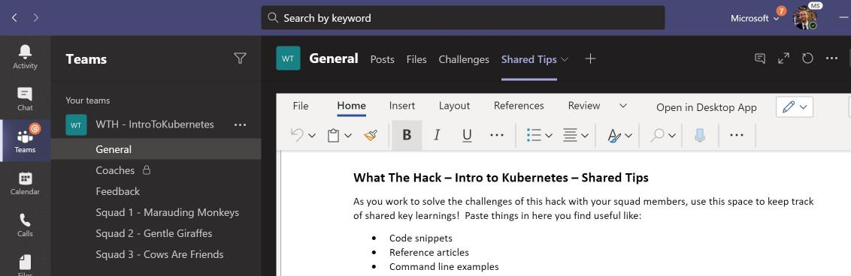
Collaboration We’re going to use Microsoft Teams in a different way…
Share tips, tricks, gotchas (how you solved them), code snippets, and links you learn along the way HERE with everyone
Notes:
Demo: Show an already created event Teams site inside of the Teams client

Slide 12
Collaboration We’re going to use Microsoft Teams in a different way…
Private channel for coaches to discuss event logistics
(students won’t see this ☺)

Slide 13
Collaboration We’re going to use Microsoft Teams in a different way…
DURING & after the event, share feedback with the coaches in the Feedback channel. This will help them improve the event as it progresses and make the next one even better

Slide 14
Collaboration We’re going to use Microsoft Teams in a different way…
Hang out, communicate, talk, and screenshare with squad members in your squad’s channel.

Slide 15
Hacking Remotely
Expectations, Tips, & Tricks
Everyone expected to be joined to their squad’s “party line” throughout the event
Mics on at all time (kids, significant others, & pet noises okay, but please mute the toilet flushes ☺)
Coaches should keep cameras on. Students optional, but preferred
Coaches will designate a “driver” for each challenge to lead by sharing their screen. Students should take turns driving (or backseat driving)!
Coaches will set break times throughout the day. Use them and walk away from your screen!
Notes:
Only show this slide if you’re hosting a virtual event or have remote attendees

Slide 16

Challenge Format
Challenges are cumulative, building upon each other.
Establish Confidence – start small and simple (think hello world)
Build Competence – by having successively more complex challenges
Challenges are NOT step-by-step hands-on labs!
No “clicking here” or “copy n pasting there”
Challenge definitions are short. A couple of sentences or bullet points stating the end goal(s) and perhaps a hint at the skill(s) needed.
You MUST work together as a team to figure out how to complete them!

Slide 17
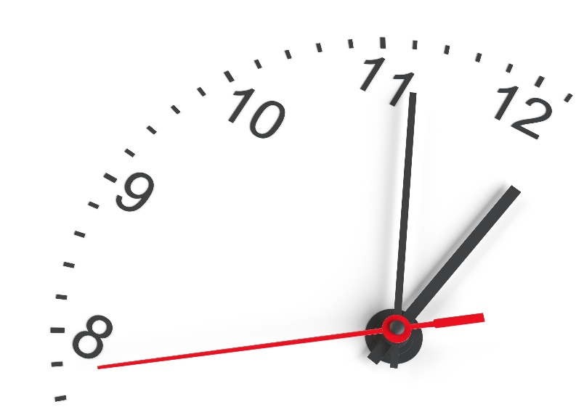
Challenge Format
For each challenge we will deliver a ”mini-lecture” explaining concepts in it.
Coaches will review results for each challenge when all squad members have completed the challenge
Don’t be beholden by the clock!
Move quickly or take it slow.
But stay together with your squad!
Your coach is there to help.
There WILL be more challenges than you can complete in our allotted time!
These are takeaways for follow up at home or with customers!

Slide 18
Coaches
Each team will have a coach through-out the whole hack.
Use them! But don’t expect them to give you all the answers.
Get to know your coach, their likes and dislikes...
All the better to find a bribe that works!
Notes:
Keep the teams working as teams!
Encourage all to “learn from” and “share with” each other!
If you observe individuals racing ahead, encourage them to help those who are behind.
Encourage attendees to use their team’s channel on MS Teams to collaborate/share info!
Unblock teams who get stuck
Encourage team members to unblock each other first!
Provide hints, but not answers
If you observe individuals stuck for a while, help them get moving so they don’t lose interest.
Provide hints/pointers to the teams on how to solve problems & where to find information.
Use the answers/solutions in the proctor’s guide, but don’t share with the attendees
Proctor’s guide won’t be comprehensive. As SMEs, proctors should use their knowledge to help with solution hints/ideas.
Notify the emcee of unexpected blockers that arise during the event so they can be communicated to all, and recorded for future reference.

Slide 19

Tooling
You can use any tooling you want, but we strongly encourage (and will only support the following):
-- insert your list of required tooling here --
-- Eg: Visual Studio Code
-- Eg: Windows Subsystem for Linux with the Azure CLI installed.

Slide 20
Finding Answers
Search engines are your friend! Azure is a hot technology and much ink has been spilled on it.
The Azure docs are your best bet.
Many of the related open source projects used here have top notch documentation!

Slide 21

And now death by Power Point…

Slide 22
And now death by Power Point… (just kidding!)

Slide 23
Automating Incremental Pipelines (Azure SQL -> Synapse Dedicated Pool)
Scenario
Be able to setup an environment to incrementally copy data from an Azure SQL Database to a Synapse Dedicated Pool.
All tables should be copied initially but only choose a few for incremental copying.
Use a watermark table to validate last copied execution in case of a trigger failure.
Use of Staging Tables and how to copy those to production tables and use the proper distribution model.
Resources are available for you
How does this compare to Synapse Link for Azure SQL?

Slide 24
Automating Incremental Pipelines (Azure SQL -> Synapse Dedicated Pool)
Overview
Challenge 0: Setup the source and target environments
Standup and configure the Azure SQL and Synapse Environments
Challenge 1: Initial Data Load into the Dedicated Pool
Use Synapse Pipelines to perform the initial data load
Challenge 2: Create Incremental Load Pipelines
Implement Change Data Capture, create the synapse pipelines and the proper Dedicated Pool architecture to be used as a target for the pipelines and a source for reporting.
Challenge 3: Setup the trigger to automate the incremental load
Create the trigger within Synapse to automate the pipeline and add data to SQL and watch it flow through the staging and production tables in the dedicated pool and viewable in your Power BI Report.

Slide 25
Automating Incremental Pipelines (Azure SQL -> Synapse Dedicated Pool)
Suggested Agenda
Day 1
Challenge 0: Setup the source and target environments
Challenge 1: Initial Data Load into the Dedicated Pool
Day 2
Challenge 2: Create Incremental Load Pipelines
Day 3
Challenge 2: Create Incremental Load Pipelines
Challenge 3: Setup the trigger to automate the incremental load

Slide 26
Automating Incremental Pipelines (Azure SQL -> Synapse Dedicated Pool)
Team Interaction
2 Teams
Squad 1 – Steve DeMarco, Mark Badger, Saswata Sengupta, Ali Asgar Juzer
Squad 2 – Milind Modi, James Xu, Rodney Elmore, Jordan Bean
Please utilize your Teams channel for your squad collaboration
Use the Meet button within your channel to collaborate together.
Share screens, chat as needed, etc.
Video is optional
Only mute when necessary… family background noise is part of life these days

